Slide 1

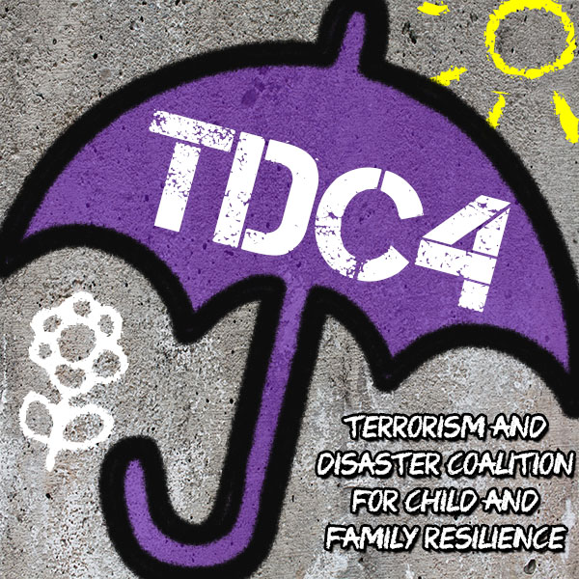

Terrorism and Disaster Coalition for Child and Family Resilience
Translating Key Issues to Action Centered Policy

Slide 2
Sponsors
Substance Abuse and Mental Health Services Administration (SAMHSA)
Louisiana State University Health Sciences Center-New Orleans, Departments of Psychiatry and Pediatrics

Slide 3
Development of the Gulf Coast Coalition
Project Goals
The project goals are to identify strengths, needs, and unique differences within each specified region
Develop products for use by providers and the public as tools to enhance preparedness planning and response and recovery activities following extreme events
Through a 5-year process with a community-based participatory planning model, foster and enhance personal and community resilience within children and their family members with respect to preparedness, response, and recovery from extreme events.

Slide 4
Emphasis for Coalitions is long-term recovery
Long-term intervention is provided by the indigenous child and family treatment resources.
Traditional provider agencies and locations include schools, religious institutions, and community health/mental health and social service agencies.
As long-term recovery issues emerge providers often have limited access to the trauma-informed knowledge-base and resources necessary to provide trauma-informed assistance to children and families.

Slide 5
Initial Project Activities:
Year One
I. Identify at least 5 Core Coalition Members from each of the Gulf Coast States
  Individual state meetings in AL, FL, LA, MS, and TX
    Discussed special needs relevant to each state, cultural considerations, organizational and structural challenges, and unique disaster or critical incidents.
    Identified potential affiliate members
Notes:
Held individual state meetings and then the regional meeting in New Orleans. Our thought was that we would hold conference calls with coalition members to develop plans to address the essential first steps.

Slide 6
Site Membership by Gulf Coast State
State | Affiliate | Cat II | Cat III | University | State | Total Site Membership | Individual Membershp
Alabama | 5 | 0 | 0 | 1 | 3 | 9 | 23
Florida | 4 | 0 | 3 | 2 | 2 | 11 | 20
Louisiana | 0 | 1 | 1 | 2 | 2 | 6 | 25
Mississippi | 2 | 0 | 0 | 1 | 2 | 5 | 23
Texas | 7 | 1 | 3 | 1 | 2 | 15 | 22

Slide 7
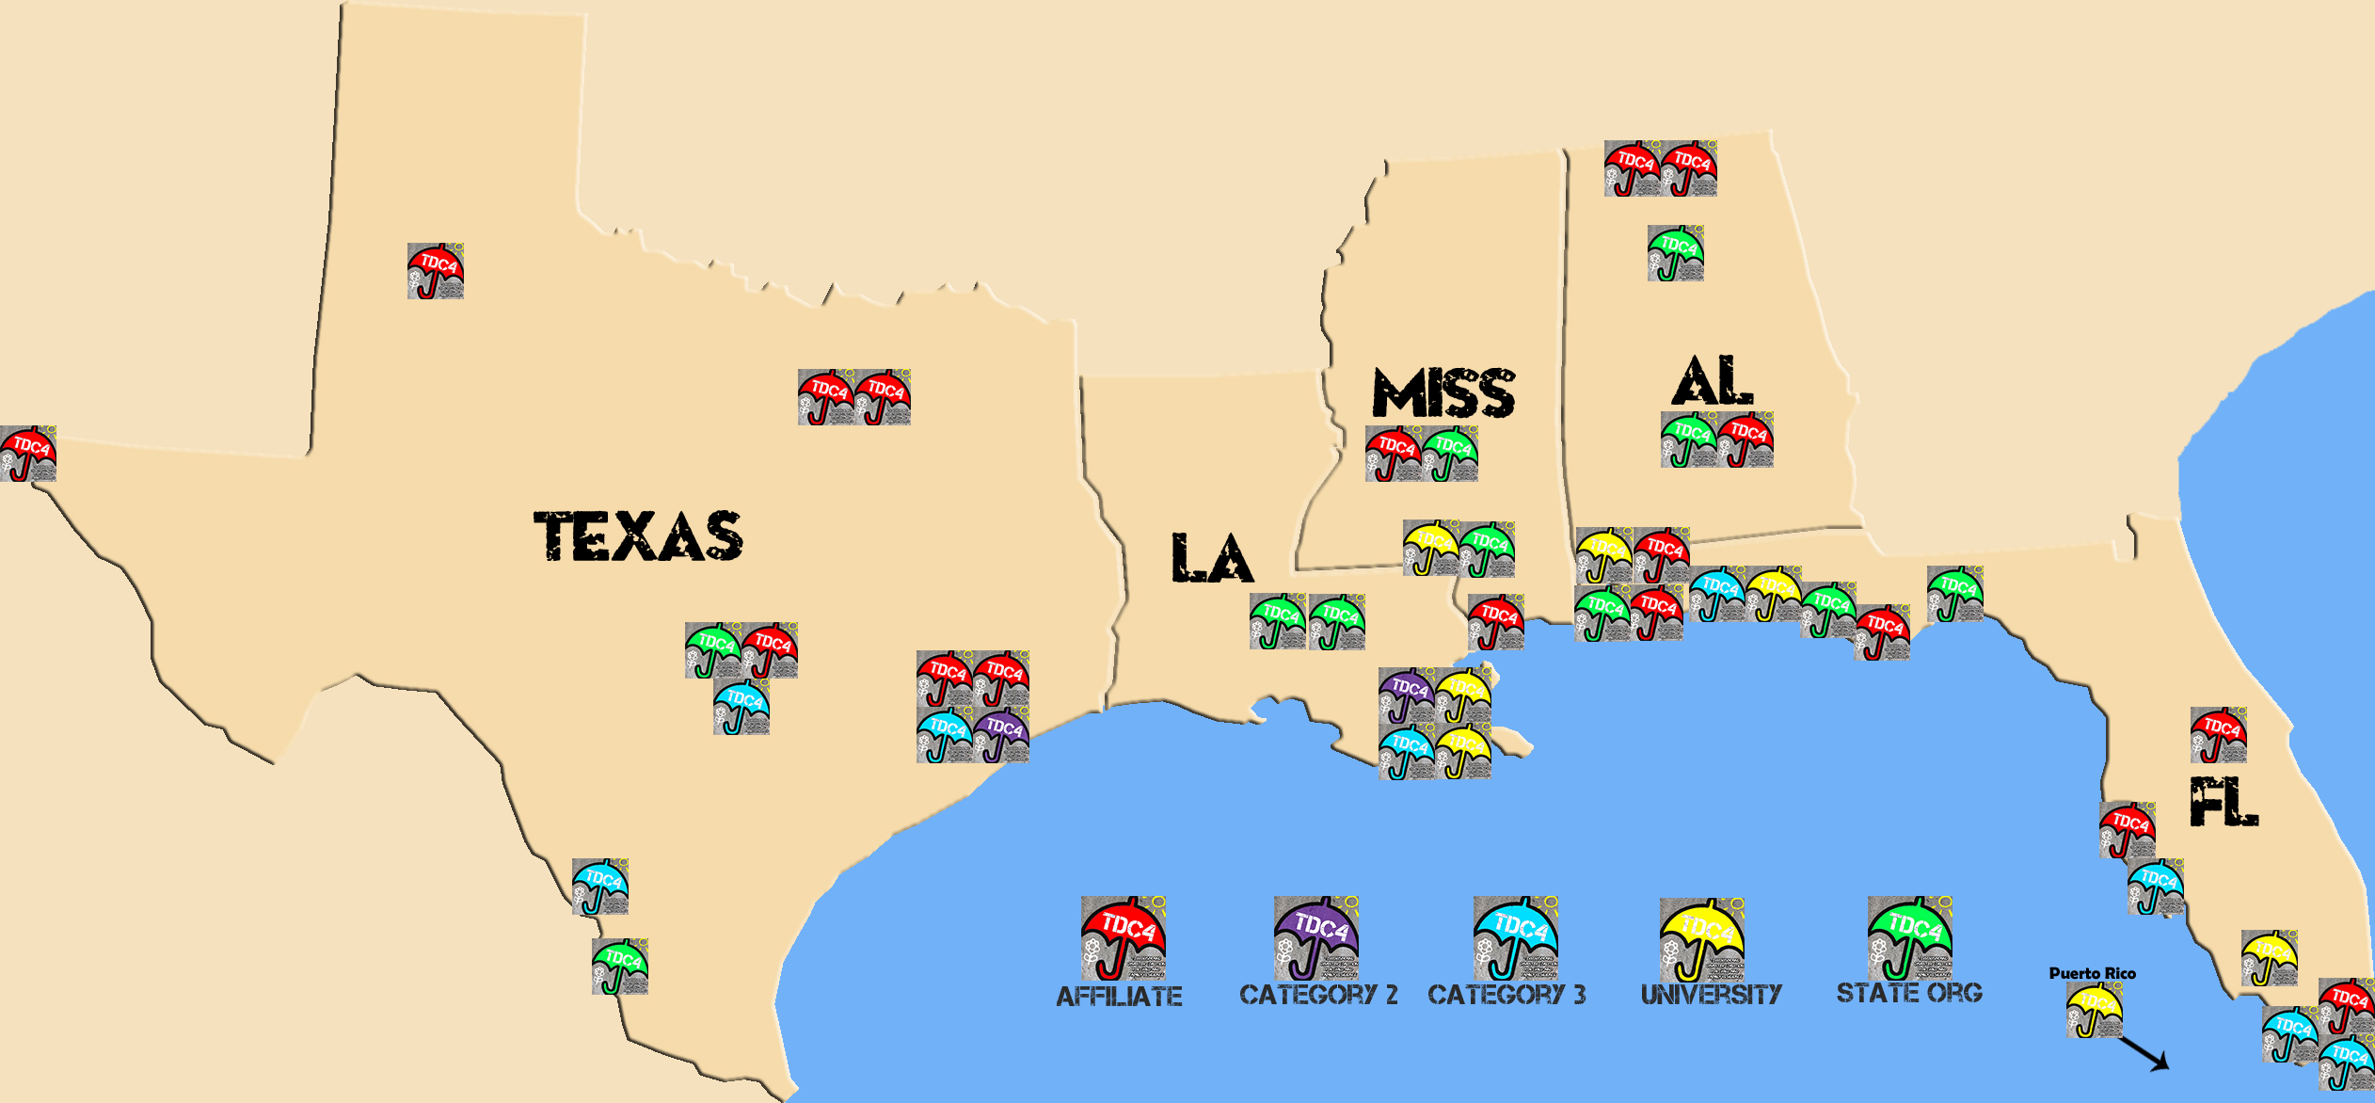

Slide 8
Themes Identified in State-Level Meetings: Gaps and Challenges
Children as a special population
  Screening for symptoms, helping adults talk to children about disasters, and school response.
Community Involvement
  Culturally informed disaster response, engaging subject matter experts.
Disaster and Trauma-Informed Services
  Lack of knowledge regarding macro-level response and services for long-term recovery.
Communication and Messaging
  Effective communication following incidents.

Slide 9
Essential First Steps for Launching the Gulf Coast Coalition
  Needs and Strengths Assessment
  Strategic planning for Year 1
  Identify resources across the coalition.
    Disseminate resources to local providers
  Develop expertise with NCTSN behavioral health tools and products, and their adaptation to the diversity within and among different community norms.
    Help to adapt and develop PFA-S, Help Kids Cope

Slide 10
Natural Disasters along the Gulf Coast (2016-2018)
Flood in Baton Rouge and surrounding parishes (August 2016)
Early 2017, two rare EF-3 tornadoes in New Orleans and Hattiesburg
_______________________________________________
Hurricane Harvey: Texas landfall- August 25, 2017
Hurricane Irma: Caribbean Islands- Sept. 6, 2017; Florida- Sept. 10, 2017
Hurricane Maria: Puerto Rico and USVI- Sept. 20, 2017
Active tornado season in Mississippi- April 2018
Notes:
Our plan was to systematically work toward addressing those essential first steps.
What we did not anticipate was the extreme weather events that would impact the gulf coast within 2 weeks of the regional meeting.

Slide 11
Coalition partnerships in disaster response (2017-2018)
Hurricanes:
  Hurricane Harvey (08/25/2017)
  Hurricane Irma (09/10/2017)
  Hurricane Maria (09/20/2017)
  Tornadoes: Al, MS, TX, LA , FL
  1,418 Tornadoes reported in the USA in 2017
  38 fatalities in 2017
Confirmed tornadoes by Enhanced Fujita rating
EFU | EF0 | EF1 | EF2 | EF3 | EF4 | EF5 | Total
67 | 615 | 593 | 128 | 13 | 2 | 0 | 1,418

Slide 12
Extreme Events in the Gulf Coast: Critical Incidents of Mass Violence
Mass shooting events
  Pulse nightclub- Orlando, FL (06/12/2016)
  First Baptist Church- Sutherland Springs, TX (11/05/2017)
  Marjory Stoneman Douglas High School- Parkland, FL (02/14/2018)
  Santa Fe High School Santa Fe, Texas(05/18/2018)
Notes:
Additionally, we had other mass shooting events. As a nation and a coalition we recognized how these mass shooting events impacted children in schools, their families, and the community as a whole.

Slide 13
Review of Conference Calls
Community needs identified by coalition

Slide 14
Overview of Conference Calls
More frequent calls immediately following weather disasters
  Widespread impacts of Harvey, Irma, and Maria
  Disasters within disasters
  Coalition members reaching out for, as well as sharing resources
  Developing Products
    Top 10 Considerations for Mental Health Professionals Working in Schools after a Disaster
    Hurricane Recovery for Children video
    Webinars
  Need to address other critical incidents outside of natural disasters, technological disasters, and terrorism.

Slide 15
Coalition partnerships in disaster response (2017-2018)
Hurricane Harvey and Katrina Response
https://www.cnn.com/2017/08/25/us/hurricane-harvey-compare-storms-trnd/index.html
Just-in-time Response Roles

Slide 16
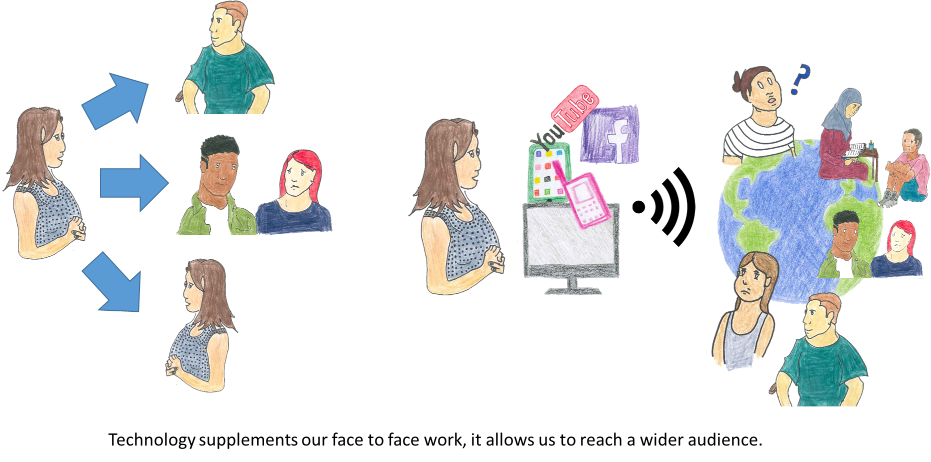
Coalition partnerships in product development and enhanced social -media evolving strategies and information sharing

Slide 17
Where we are today…
Two Major Themes
(1) Disaster Planning
Preparedness to
Recovery
(2) Extreme Events involving Mass Violence
School Shootings
Churches
Public Events
Entertainment Venues

Slide 18
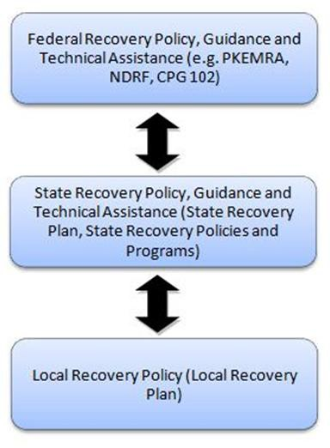
Three Tiers of Planning, Response, and Recovery

Slide 19
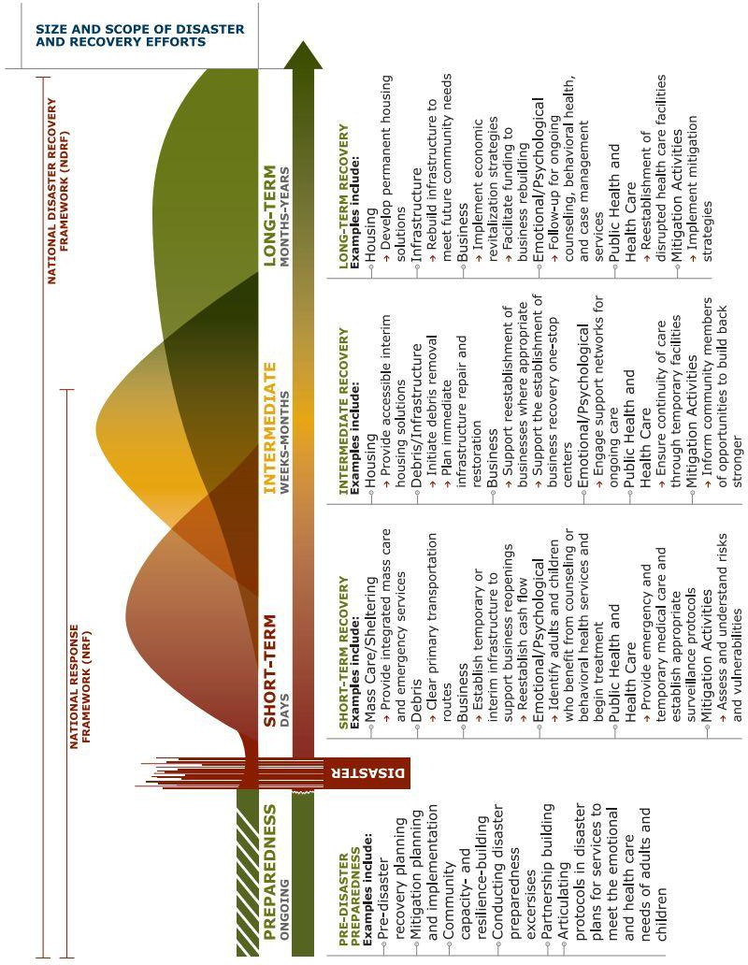

Slide 20
Themes and related Issues
Identified by Coalition Members:
School Shootings and extreme Events/Mass Violence | Standing committee on long-term recovery issues | First -responder support, stress management cadre supporting state/local operations staff and leadership | Specialize response and planning with schools and leadership
Long-term planning. Staff self-care and self awareness | NGO and Stakeholder training and involvement | Most traumatized children. Mobilization of response resources (EMAC) | Collaborative planning with state and county Emergency Management /FEMA
Just-in-time training/ translation of materials | Foster Care/ juvenile justice/ homeless children | Siloed systems hard to negotiate | Shaping DBH so others can accept it as a EM tool
Opioid and other substance use issues response/recovery High-risk groups | Mass shootings in school--- trauma exposure and recovery | Recognizing LT impact of per0existing trauma.. | Suicide prevalence rates Bereavement Centers
School status and roles /community | Community organization roles Business Continuity plans | After the press leaves…what then? | Unexpected challenges and needs …USVI and Puerto Rico
Family structure and resources | ALICE Training | Prevention and intervention | Marketing/ training

